Slide 1
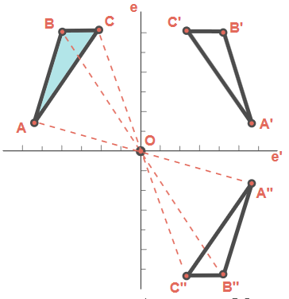
Transformation Geometry
Mr. McCarthy

Slide 2
What is Transformation Geometry?
What is a transformation?
A transformation is a ‘change’.
Geometry is the shapes and figures we study in technical graphics.
Transformation Geometry is the study of the movement of shapes under different transformations.

Slide 3
What do we study in Transformation Geometry?
There are 5 transformations in Transformation Geometry:
Axial Symmetry
Translation
Central Symmetry
Enlargements & Reductions
Rotations

Slide 4
Axial Symmetry
Very useful for other topics in Technical Graphics.
It is the study of creating the mirror image of a shape about an axis.
Symmetry means that something is equal on one side to the other.
Axis of Symmetry

Slide 5
Where have we seen Axial Symmetry before?
The letters on an AMBULANCE.
Folding paper in half, then cutting it. Unfolding it will replicate the same cut on the opposite side.

Slide 6
How does Axial Symmetry work?
An Image on a plane is rotated about the axis.
The axis of symmetry is on the edge of the plane.
The plane shown is rotated about the axis until the image is mirrored.

Slide 7
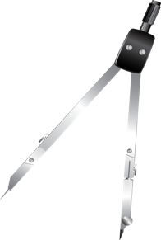
How to draw an image under Axial Symmetry
Axis of Symmetry

Slide 8
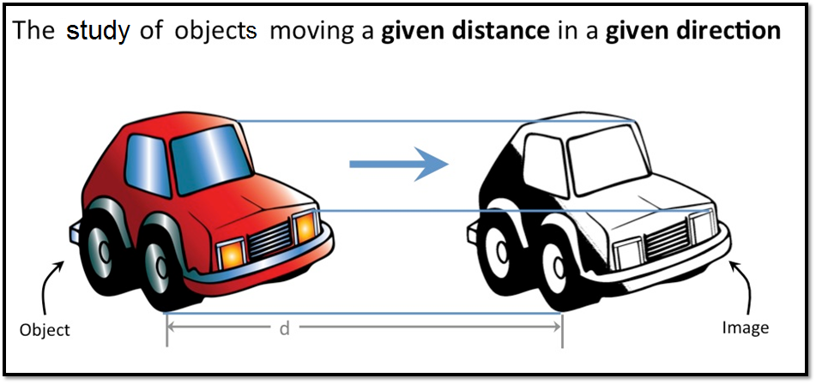
Translation

Slide 9
How to draw an image under Translation
A1
Direction and Distance
A
All parallel to the original direction and distance

Slide 10
Central Symmetry

Slide 11
How to draw an image under Central Symmetry
C
Centre of Symmetry

Slide 12
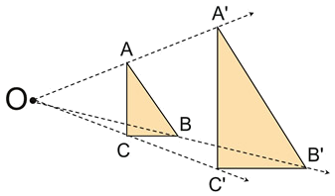
Enlargements & Reductions
Enlargements and Reductions do exactly as they say on the tin.
Enlargements increase the size of an image.
Reductions reduce the size of an image.

Slide 13
How to Enlarge an image A-A1
Lines remain parallel to original corresponding lines
A1
A
O

Slide 14
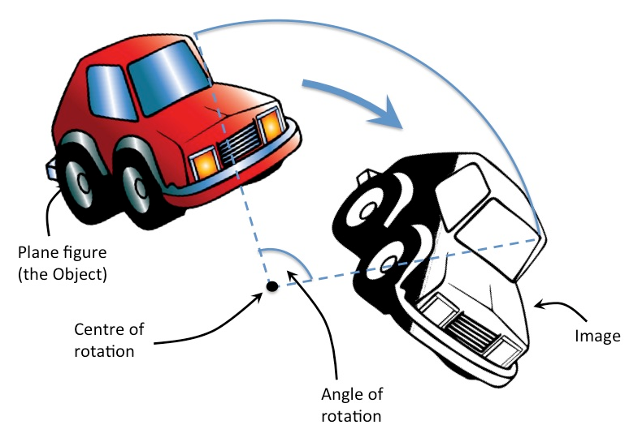
Rotations
The study of rotating an image a certain given angle about a point.

Slide 15
How to Rotate an Image
Ɵ =
Given Angle
A
Ɵ
A1
Ɵ
Ɵ
Ɵ
Centre of Rotation

