Slide 1
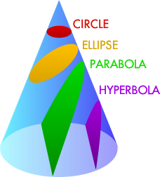
The Parabola
The Parabola is a shape that comes from a conic section. A conic section is a cut section of a cone.

Slide 2
The Everyday Parabola
The Parabola can be seen in the design of numerous landmarks worldwide and in physics theories.
Can you think of where you have seen this shape before?

Slide 3
https://www.youtube.com/watch?v=IOZVvo5p4c0
Bridge
https://www.youtube.com/watch?v=0Qt5uGdxC5s
Basketball

Slide 4
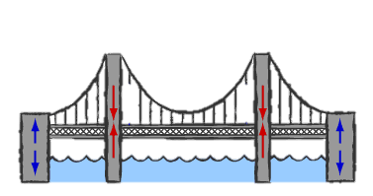
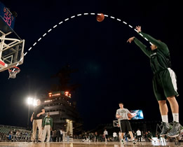
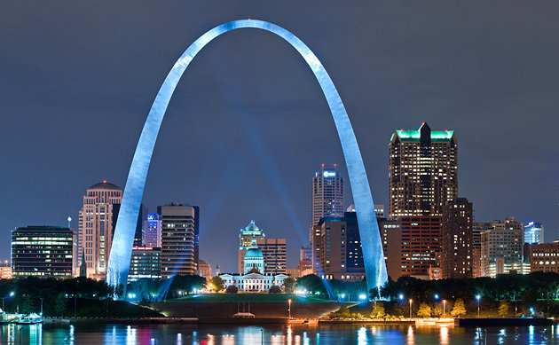

Slide 5
Construction of the Upright Parabola
Parallel
Equal divisions
Distance doesn’t
matter

Slide 6
Inverted Construction
Parallel
Equal divisions
Distance doesn’t
matter

