Slide 1
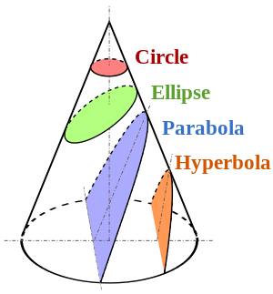
The Ellipse
Mr. McCarthy

Slide 2
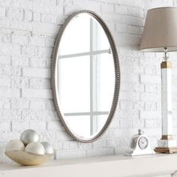
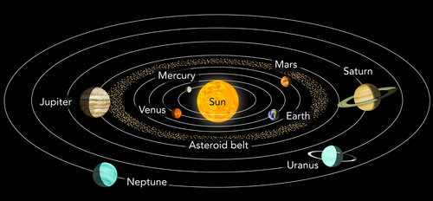
The Everyday Ellipse
The ellipse can be seen in numerous places in our everyday lives.
Some examples include rugby balls, mirrors, the path of planets around the sun, watermelons and mirrors.
Can you think of any more?

Slide 3
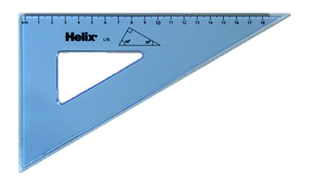
Construction of the Horizontal Ellipse
Major Axis
Minor Axis
60°
30°

Slide 4
Construction of the Vertical Ellipse
Major Axis
Minor Axis
60°
30°

Slide 5
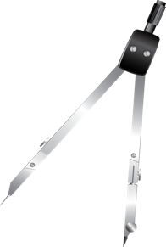
Locating Focal Points
Major Axis Ø
F
F1
½ Major Axis (r)

Slide 6
Finding the Minor Radius, given the Major Axis & the Focal Points
F
F1

Slide 7
Determining the Major Axis, given the Minor axis and the Focal Points
F
F1

Slide 8
Determining the Minor Axis, given the Major Axis and a Point on the curve
P

Slide 9
Determining the Major Axis, given the Minor Axis and a Point on the curve
P

Slide 10
Determining the Major Axis, given a Point on the curve & the Focal Points.
A + B = Major Axis
½ Major Axis
P
Major Axis
A B
F
F1

Slide 11
Drawing a Tangent & Normal to a point on the curve
Tangent
Normal
P
F
F1

Slide 12
Drawing a Tangent from a Point Outside the curve
P
F
F1

