Slide 1
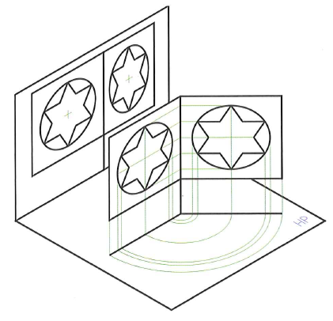
Rotations of Objects
Mr. McCarthy

Slide 2
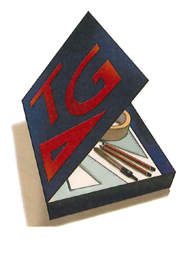
What is Rotations of Objects?
Rotations of Objects is the orthographic representation of an object after it has been rotated a certain angle into a new position.

Slide 3
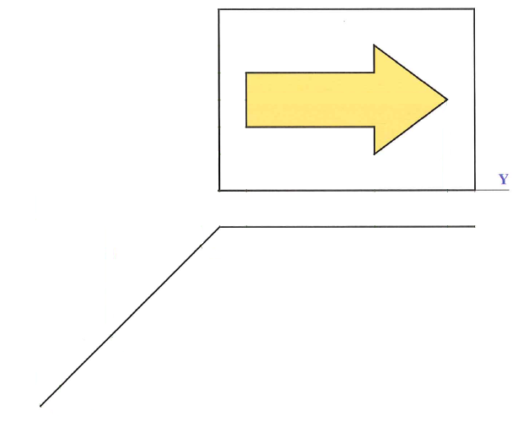
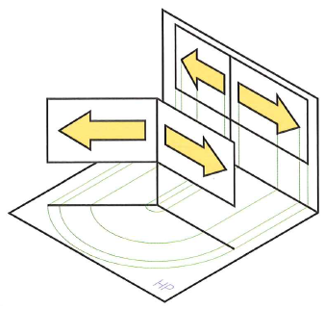
How to Rotate an Object in Plan

Slide 4
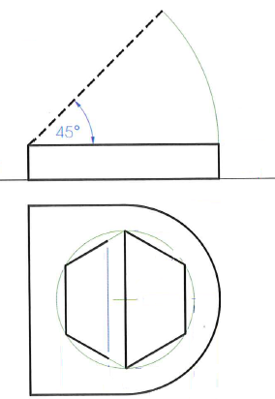
How to Rotate an Object in Elevation

Slide 5
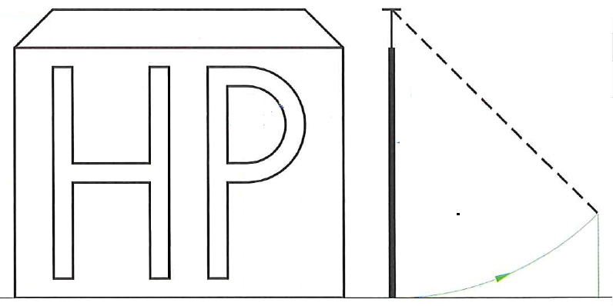
How to Rotate an Object in the End View
Center of Rotation
Repeat for Internal Arc

