Slide 1
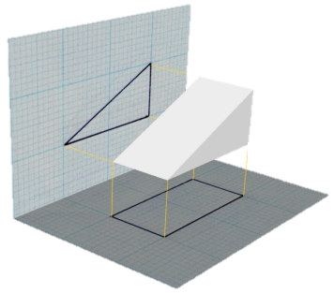
Orthographic Projection
Mr. McCarthy

Slide 2
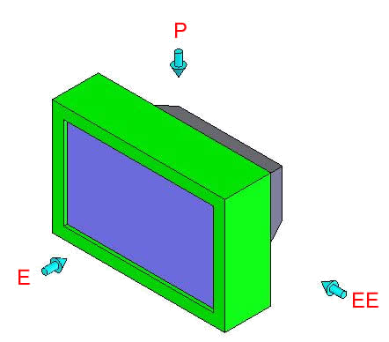
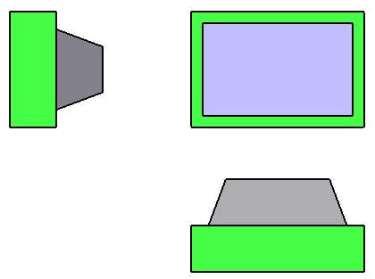
What is Orthographic Projection?
The representation of 3D geometry, projected onto a plane as a 2D drawing.
Typically shows the front, side and top details of an object.

Slide 3
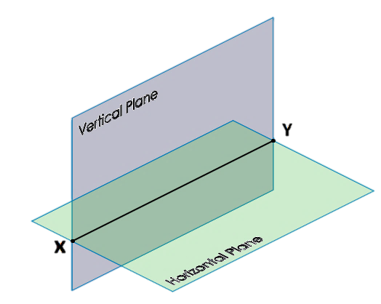
The Planes of Reference
The planes of reference are 2 imaginary intersecting planes.
They are; the horizontal plane and the vertical plane.
The intersection of these planes is the XY line.

Slide 4
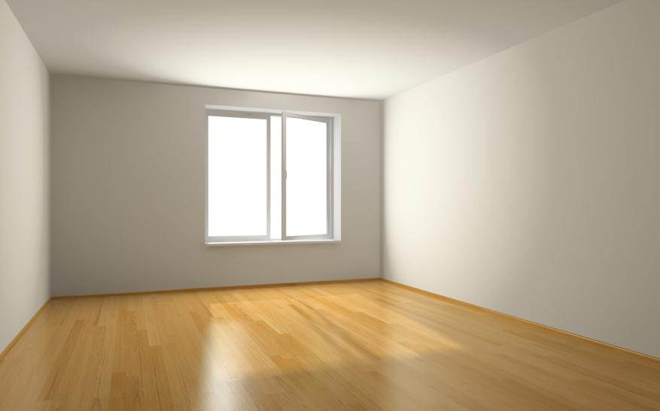
Look at the room you’re in…
The wall represents the vertical plane.
The floor represents the horizontal plane.
The skirting board represents the XY line.
Vertical Plane
X
Horizontal Plane
Y

Slide 5
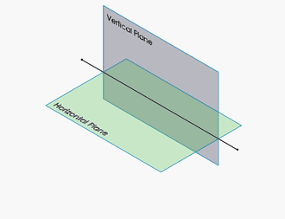
What is the X,Y line?
The line of intersection between the vertical and horizontal planes.
An edge view of the horizontal plane.
An edge view of the vertical plane.
Planes have no thickness. The edge view of the plane is represented as a line.

Slide 6
End Views / End Elevations
The End view looks in from the side of an object.
It is looking along the direction of the XY line.
X
Y

Slide 7
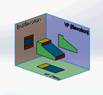
Positioning the Views
The elevation is the main drawing view and provides us with the most detail. All other views work off the elevation.
The plan is drawn under the elevation because we project down onto the HP.
The end elevation is projected to the side of the elevation. The side depends on which is asked for.

Slide 8
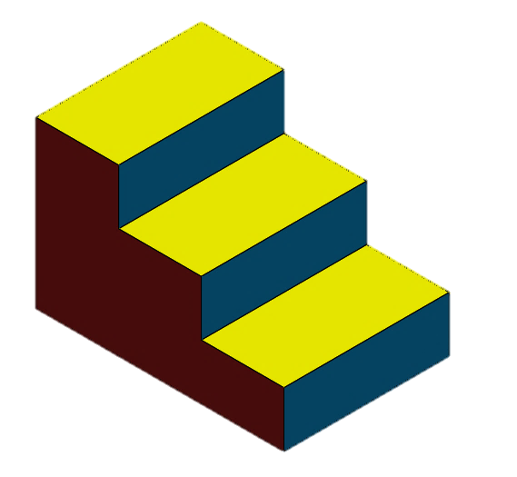
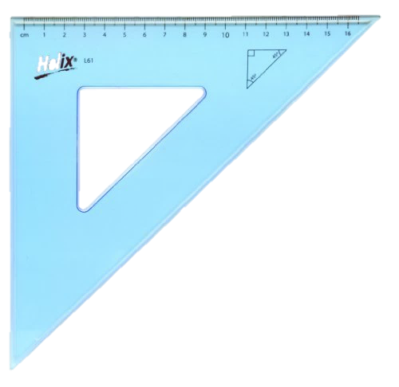
How to complete a Drawing
B
D
w
H
H1
H1
H
H1
A
H1
X Y
C
w
w
w
Complete the following for the given structure:
All spacers are equidistant.
a) Elevation
b) Plan
c) End View
End View Elevation
Any distance; usually around 20mm
D
Plan

Slide 9
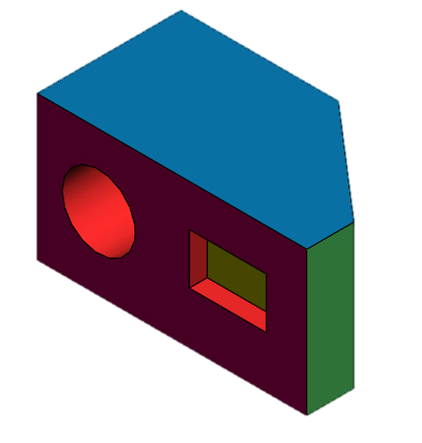
Hidden Detail
Hidden detail are the lines of an object that are behind another surface.
They are important for completing the other orthographic views where they may be required.
They are represented by a dashed lines shown.

Slide 10
Complete the End View in Direction A
A
X Y

Slide 11
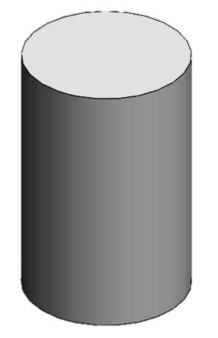
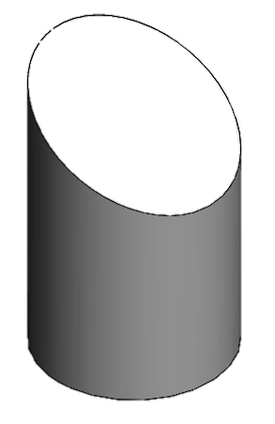
Curved Sections in Orthographic Projection
Some solids appear as circles in a particular view when they are left as full solids.
Examples are Cylinders or Cones etc.
Some solids will appear as a circle in one view but may appear as an ellipse in another view.
An example is a cut cylinder.
1.93
1.93

Slide 12
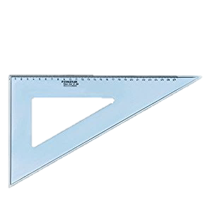
How to Complete a Curved Section
1.93

Slide 13
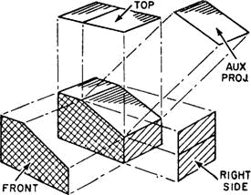
Auxiliary Projection
Auxiliaries are views that are taken at a different viewing angle to the standard isometric views.
They can be used to determine true lengths of lines, true shapes of surfaces or to get a required view.
An auxiliary is used to determine the true shape of a surface; which is question part in the HL Junior Cert exam.

Slide 14
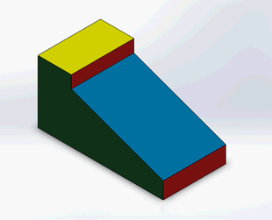
What are we doing when we draw Auxiliaries?
We are orientating the spectator into a position where he is looking perpendicular to what we want to see.
See figure for true shape auxiliary of the blue surface.

Slide 15
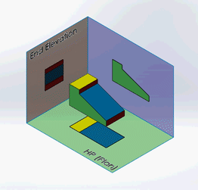
We project the object / line/ or surface onto a plane and then rotate the plane until we can look at it from our original spectator position.
We do this in drawings by going perpendicular to the edge view of the surface we are looking for.

Slide 16
Take this down….
When you’re looking for the lengths for an auxiliary…
“Skip a view and take the lengths from the next X,Y line back.”

Slide 17
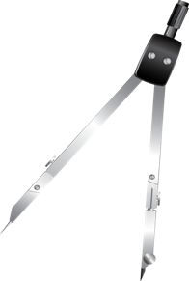
Drawing an Auxiliary
Skip a view and take them from the next XY line back.
X Y
Skipped
To get the heights for the auxiliary…
X1 Y1
True Shape

