Slide 1
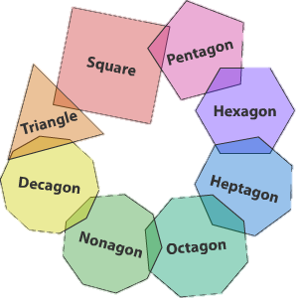
Polygons
Mr. McCarthy

Slide 2
Where have we seen polygons before?
There are many everyday examples of polygons.

Slide 3
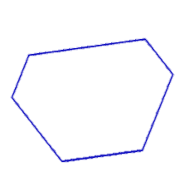
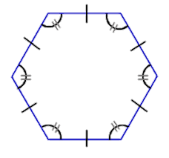
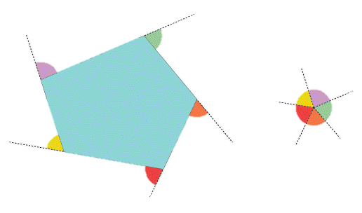
Characteristics of Polygons
All the side are the same length. All the internal and external angles are equal.
All the external angles add up to 360°.
A polygon with a side or angle different to the other is called an irregular polygon.

Slide 4
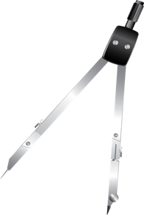
Construction of an Equilateral Triangle (compass method)

Slide 5
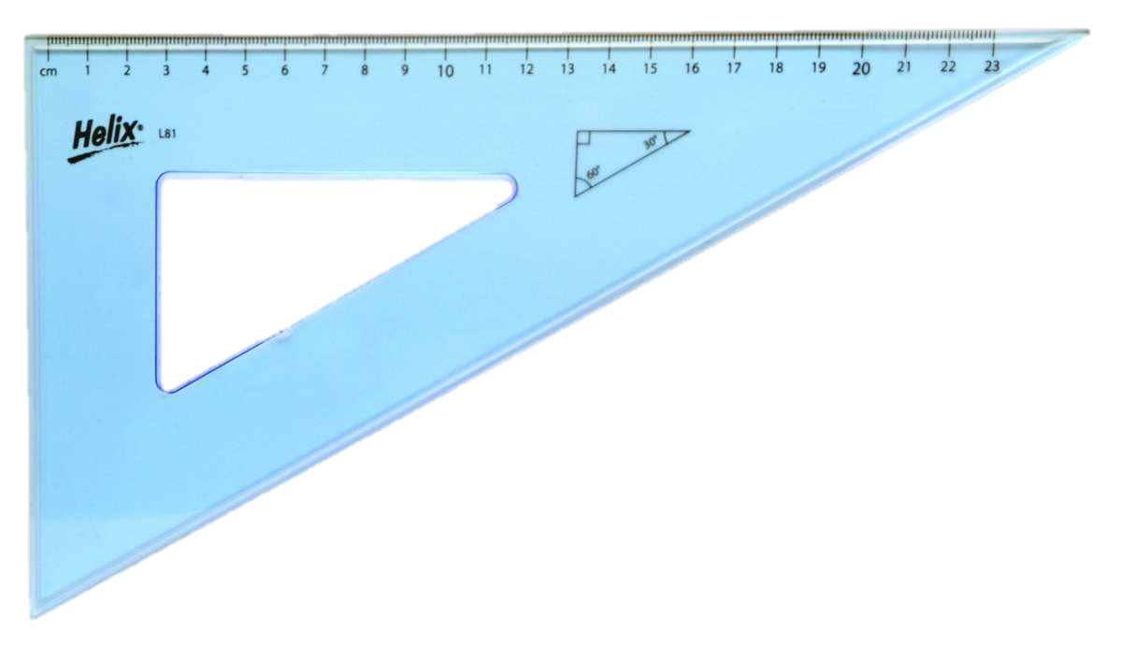
Construction of a Square

Slide 6
Construction of a Hexagon from a base line
60°
60°

Slide 7
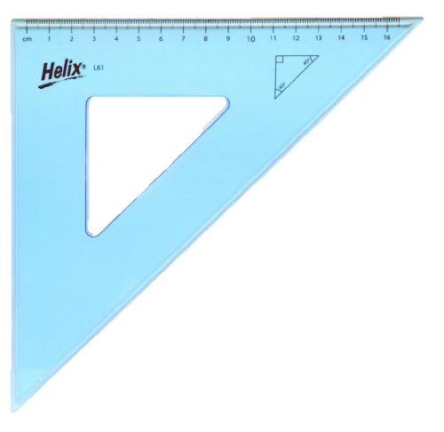
Construction of an Octagon

Slide 8
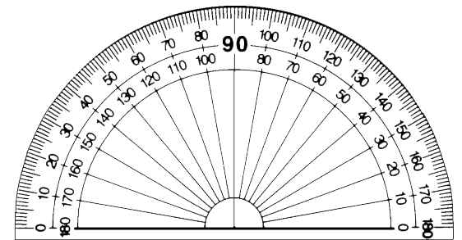
Construction of the Pentagon
72°

