Slide 1
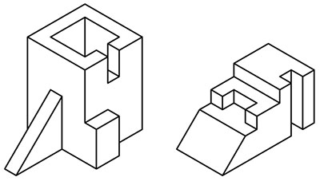
Isometric Projection
Mr. McCarthy

Slide 2
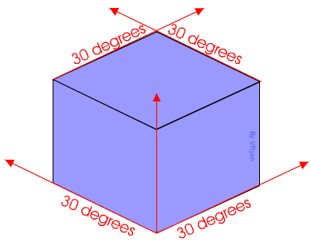
What is Isometric Projection?
Isometric Projection is a 3D representation of an object.
The object is rotated 30º.

Slide 3
How to draw an Isometric Drawing
Axonometric Method
Starts using a Equilateral Triangle.
We draw the elevation/plan/end views where required and project them to complete the drawing.
Isometric Scale Method
Starts with the ‘crows foot’.
Applies the lengths, widths and heights along the corresponding axis.
The isometric scale must be used to foreshorten the drawing to give a more realistic view.

Slide 4
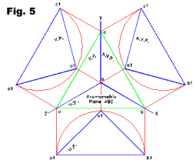
Axonometric Method
Uses the relevant (requires 2) orthographic views and an equilateral triangle to produce an isometric drawing.
ELEVATION/END VIEW
ELEVATION/END VIEW
PLAN

Slide 5
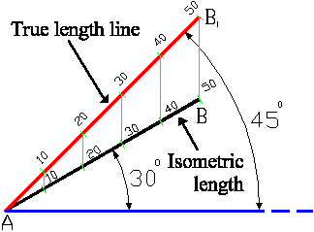
Isometric Scale Method
Uses the ‘crows foot’ system to draw questions (vertical line, 2 lines at 30º).
Widths, lengths and heights are applied along these axes.
The Isometric scale alters the dimensions given in the question to make them appear a more lifelike size.

Slide 6
How to use the Axonometric Method
End View
Elevation
B
A
As you can see, we only required 2 orthographic views
The blue circle is a hole that passes fully through.
Plan

Slide 7
How to Use the ‘Crows foot’ Method
B
A
The blue circle is a hole that passes fully through.

Slide 8
Circles in Isometric Using the ‘Crows foot’
B
A

Slide 9
How to use the Isometric Scale
45º
30º
True / Given Length
Isometric Length
Apply Dimension
45º
30º

Slide 10
Drawing Spheres in Isometric
How should a sphere appear in isometric?
What shape is a sphere from the direction you’re looking at it from?

Slide 11
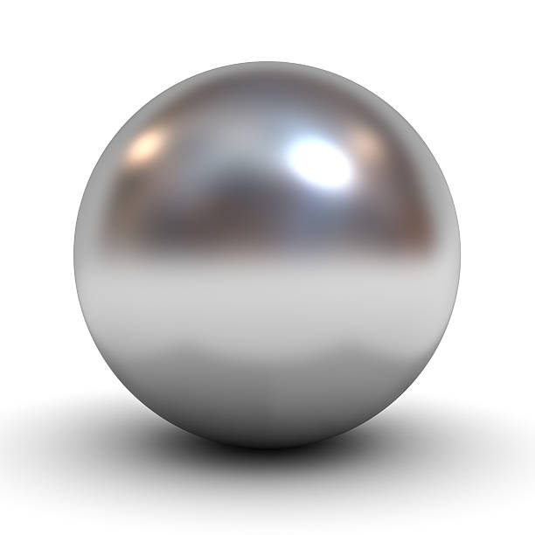
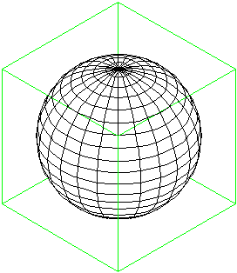
Spheres appear as Circles… Always!
Spheres in isometric will always appear as a circle because they are the same shape no matter what direction you view them in.

Slide 12
How to draw a Sphere
Apply the height given in the orthographic, along the centre line to get the centre of the sphere.
Join the corners to get the centre.

