Slide 1
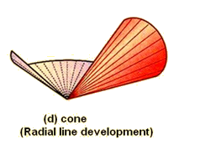
Developments
Mr. McCarthy

Slide 2
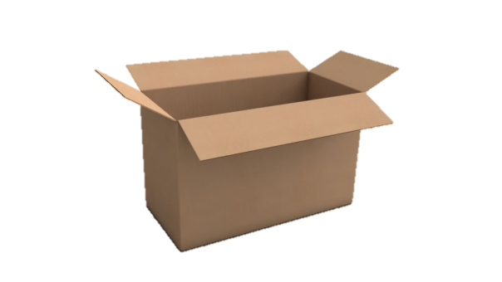
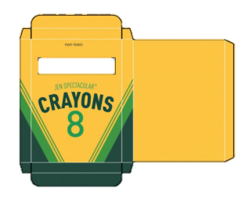
What is a development?
A development is the unravelling of any object or 3D structure.
The opposite of a development of is the envelopments, but we are not concerned with envelopments until senior cycle.
Where have we seen developments before?

Slide 3
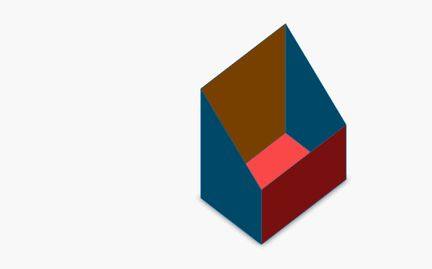
The Development of a Common Object

Slide 4
Line Types
The outline for a development is done using a standard solid line.
The lines used to indicate bends in the drawing are called ‘Phantom Lines’. They are commonly called bend lines incorrectly.
Solid Lines (for outlines)
Incorrect Phantom Lines (commonly used in text books)
Correct Phantom Lines (long line, 2 short dash)

Slide 5
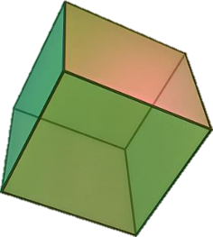
Development of a Cube

Slide 6
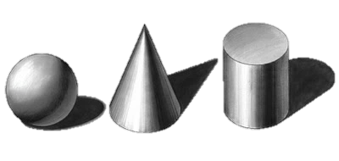
Do Cylinders, Cones and other curved objects require phantom lines?
If so…. Why? If not…. Why?

Slide 7
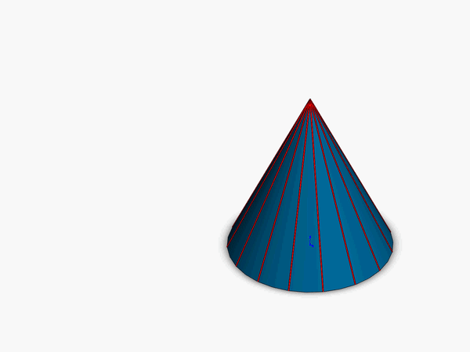
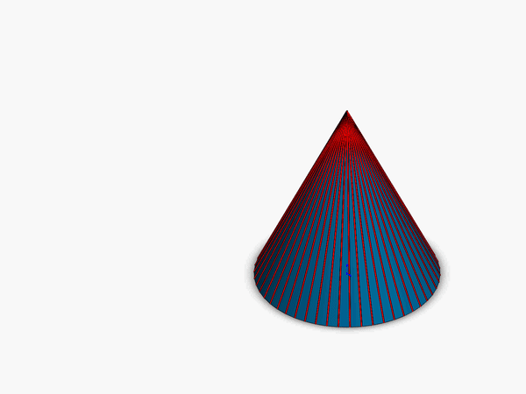
They Don’t.
Curved objects and features are made up of an infinite amount of bend points because it is one continuous curve.
A continuous bend cannot be represented by one specific bend line.

Slide 8
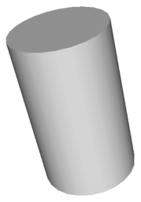
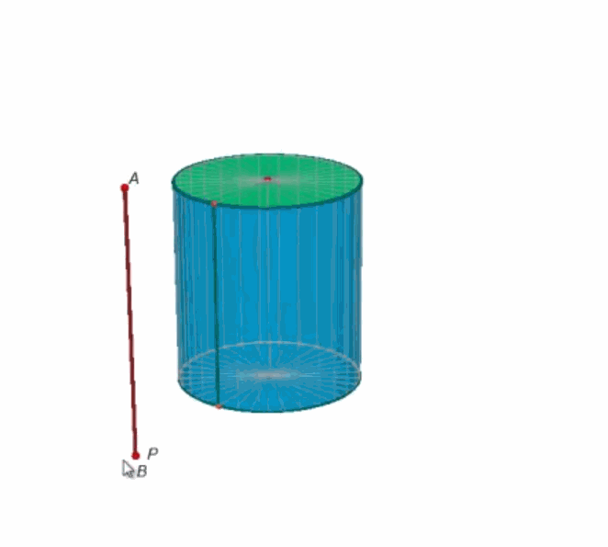
Cylinder Development
Height is a constant.
We use small, equal sections of the cylinder to work out the length of the development.
The alternative to this method is using 2 π r. This is the formula for the circumference of a circle.

Slide 9
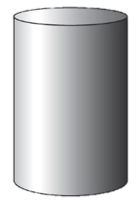
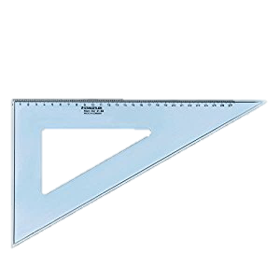
Development of a Cylinder
x
No Phantom Lines
12 Divisions
x

Slide 10
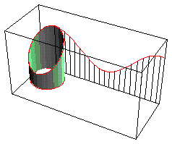
Truncated Cylinders
Usually have a long side and a short side.
We always begin and end the development with the shortest edge.
The development will rise and fall over one full development of the shape.

Slide 11
Angular Cut (Truncated)Cylinders
x
No Phantom Lines
Always start with the shortest edge
x

Slide 12
True Lengths
The true length of a line gives us the actual length of the line.
The true length of a line is shown when we look at the line perpendicular.

Slide 13
Cone True Edge Lengths
When we look at the cones below; which of the cones do we see the true length of the red lines?
A B C D E

Slide 14
Development of a Cone
P
General True length Rule:
If a line is parallel to the XY line in one view; it’s a true length in the other
True Length
P
No Phantom Lines
Not A True Length
X Y
x
x

Slide 15
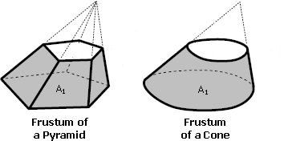
Frustums
A frustum is the section of a solid after it has been cut by a plan parallel to the horizontal plane.
After the solid has been cut it is called truncated. Truncated solids may not be cut parallel to the HP.
The figures shown are truncated solids; they show the frustum of their solid.

Slide 16
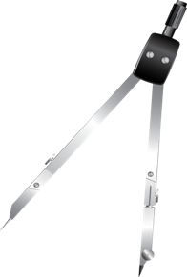
Development of a Truncated Cone
P
True Length
P
X Y
Mr. McCarthy © Principles of Graphics
No Phantom Lines

